Slide 1

Agilis
BUILDING YOUR DIGITAL WORLD

Slide 2
Introduction to Blockchain development Tutor: Loui Mercieca Date: Oct 2018

Slide 3
Course Material
Module 1: Blockchain Under the Hood
Module 2: Ethereum Basics
Module 3: RPC and web3
Module 4: Truffle and Metamask
Module 5: Solidity Coding in Depth
Module 6: Security

Slide 4
Introduction to Blockchain

Slide 5
What is Blockchain
Problem in a network is that each machine has its own state
Blockchain is a mixture of network and a database
If one thing changes in one place it changes everywhere
It’s a book of transactions (blocks) and its append only
That is why the blockchain is deterministic
The current value of a wallet is starting 0 plus all transactions that are in/out. Therefore we need to be fully synched to work with them.

Slide 6
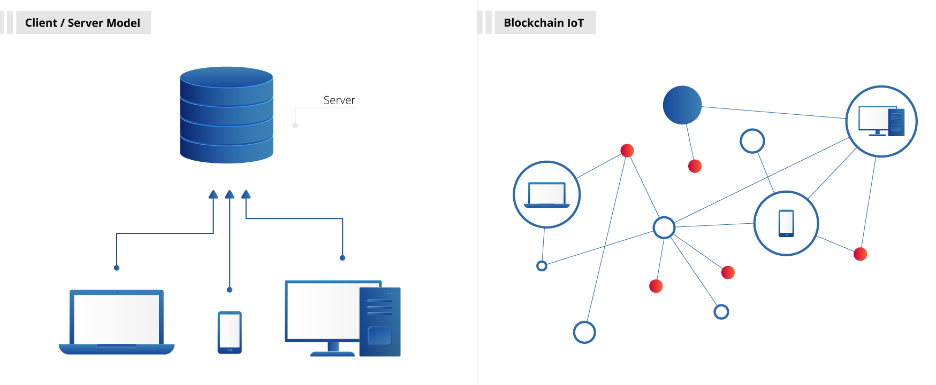
What is Blockchain

Slide 7
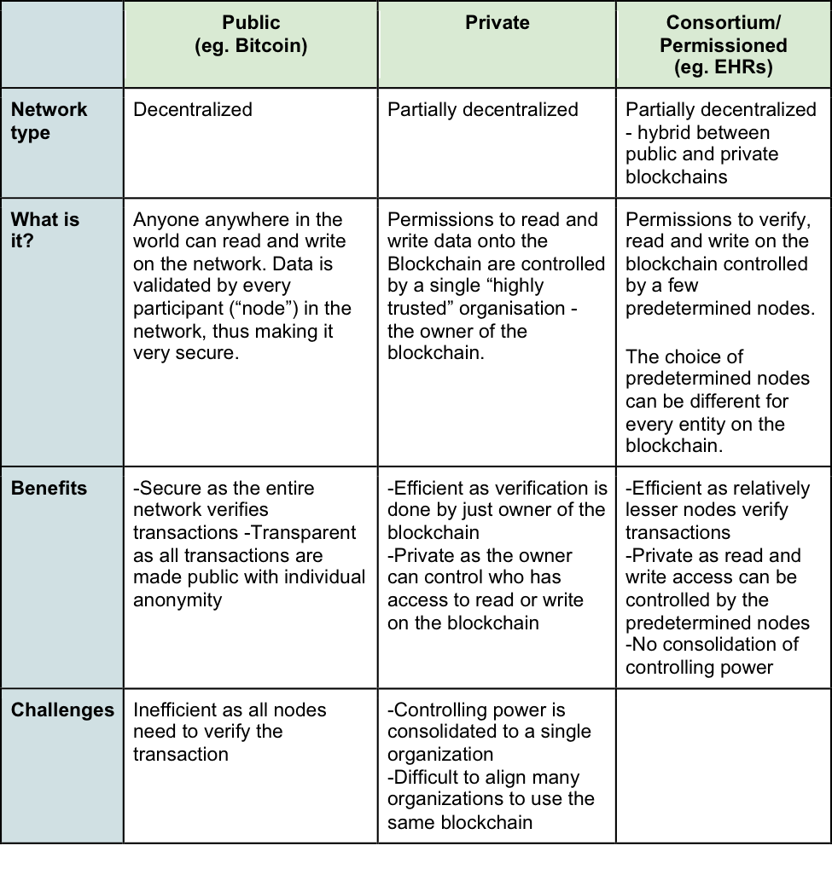

Slide 8
Cryptography
Encrypt and decrypt
Alice wants to send a message to Bob, and for Bob's eyes only:
Bob gives Alice his public key
Alice uses Bob's public key to
encrypt the message
Alice sends Bob the encrypted message
Bob decrypts the message with his private key
Sign and verify
Alice wants to make sure that Bob's public announcement is indeed from Bob:
Bob gives Alice his public key
Bob signs his announcement with his private key
Bob sends Alice his announcement and its signature
Alice verifies the signature with Bob's public key

Slide 9
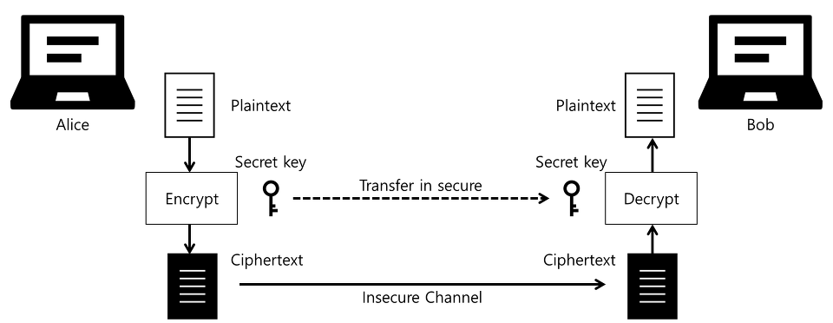
Cryptography

Slide 10
Cryptography
Mix and Match
It is possible to mix both ideas,
whereby Alice encrypts her message with Bob's public key, then signs the encrypt file with her private key.
Upon reception, Bob verifies the signature with Alice's public key, then decrypts the file with his private key.

Slide 11
Cryptography
Key management, PKI
If you look again at the Alice and Bob examples, you will notice that there is a vulnerability in "Bob gives Alice his public key".
A malicious Charlie could intercept Bob's public key and pass on his own public key to Alice.
Because of this, key management and public key infrastructure (PKI) is an important part of cryptography.

Slide 12
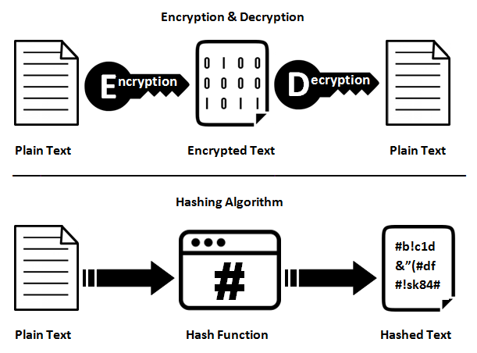
Cryptography

Slide 13
Cryptography
Cryptographic Hash Functions
Such a hash function:
converts an input, a.k.a. the message, into an output, a.k.a the hash
does the conversion in a reasonable amount of time
is such that it is practically impossible to re-generate the message out of the hash
is such that the tiniest change in the message, changes the hash beyond recognition
is such that it is practically impossible to find 2 different messages with the same hash

Slide 14
Cryptography
Cryptographic Hash Functions
With such a function, you can:
prove that you have a message without disclosing the content of the message, for instance:
to prove you know your password
to prove you previously wrote a message
rest assured the message was not altered
index your messages
.

Slide 15
Cryptography
Cryptographic Hash Functions
Bitcoin uses SHA-256.
Ethereum uses Keccak-256 & Keccak-512.

Slide 16
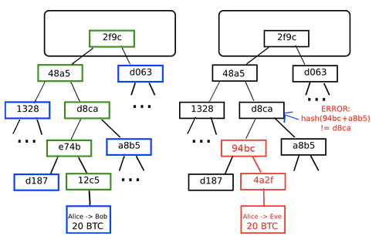
Cryptography – Merkle Tree

Slide 17
Cryptography
Merkle Tree
A Merkle tree is a tree where:
each leaf node keeps a piece of the data.
the complete data is obtained by collating the leaf nodes in a depth-first search fashion.
each parent node keeps the computed hash of its children hashes.
With a Merkle tree, you can:
keep data behind a single hash, just like a single-pass hash function would offer over the whole content.
download and verify the integrity of data pieces as they come in random order.
In a blockchain environment, each block header keeps one or more hash(es) of the top leaf of one of more merkle tree(s).

Slide 18
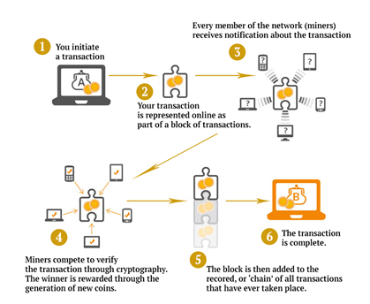
Cryptography – Mining

Slide 19
Cryptography
Mining – Further Reading
https://anders.com/blockchain/hash.html
https://www.coinwarz.com/difficulty-charts/ethereum-difficulty-chart

Slide 20
Cryptography
Gossip Protocol Network
In the same fashion as in human social networks, a computer gossip network works by having each individual node relay freshly received information to its own peers.
Such protocols vary in their aspects, such as latency or laziness.
Nodes may also choose to drop new information.
In a Bitcoin context, a new transaction is broadcast in this way if and only if it is valid.

Slide 21
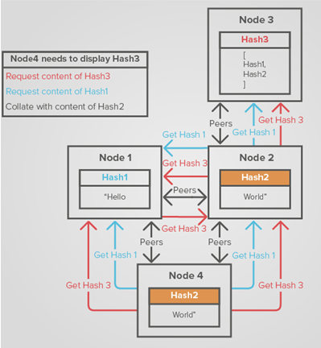
Cryptography
Gossip Protocol Network
In a gossip network a node randomly chooses to whom to broadcast and it does not wait for acknowledgements

Slide 22
Introduction to Ethereum

Slide 23
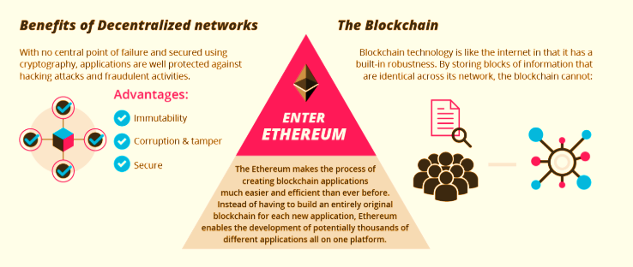
Ethereum

Slide 24
Ethereum & Smart Contracts
Ethereum adds a virtual machine that can execute code.
In each transaction data can be added, which can be a code that performs logic (smart contracts) as well as input/output to functions that change the state.
The main role of smart contracts is to update the state of the blockchain. This logic is known as smart contracts and that is what we code.
Therefore programs are immutable, they never change.

Slide 25
Ethereum & Smart Contracts
Note that "contracts" in Ethereum should not be seen as something that should be "fulfilled" or "complied with"; rather, they are more like "autonomous agents" that live inside of the Ethereum execution environment, always executing a specific piece of code when "poked" by a message or transaction, and having direct control over their own ether balance and their own key/value store to keep track of persistent variables.

Slide 26
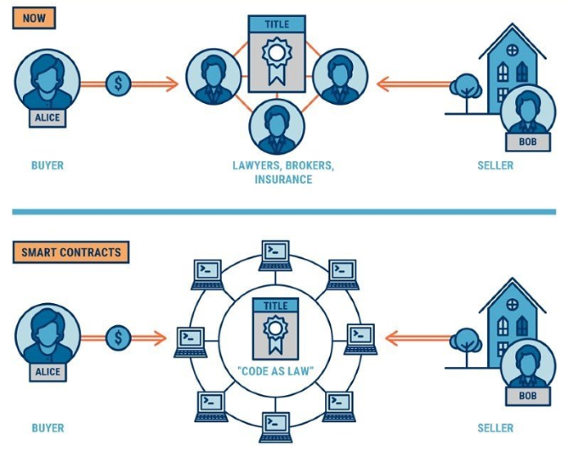

Slide 27
Ethereum
Ethereum Accounts
In Ethereum, the state is made up of objects called "accounts", with each account having a 20-byte address and state transitions being direct transfers of value and information between accounts.
An Ethereum account contains four fields:
The nonce, a counter used to make sure each transaction can only be processed once
The account's current ether balance
The account's contract code, if present
The account's storage (empty by default)

Slide 28
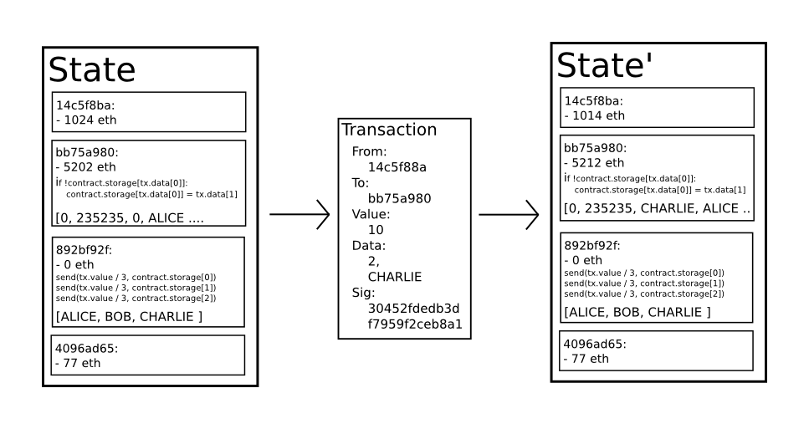
Ethereum
State Transactions

Slide 29
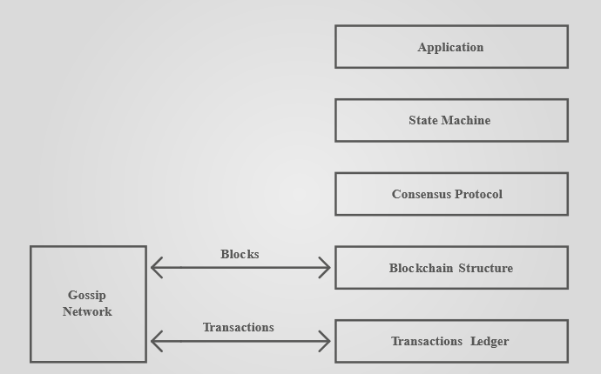
Ethereum
A transaction is an atomic event, an event whose sub-event parts make no sense in isolation.

Slide 30
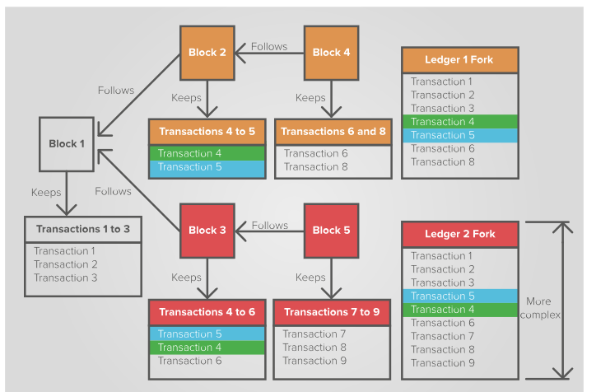
Ethereum
Forking

Slide 31
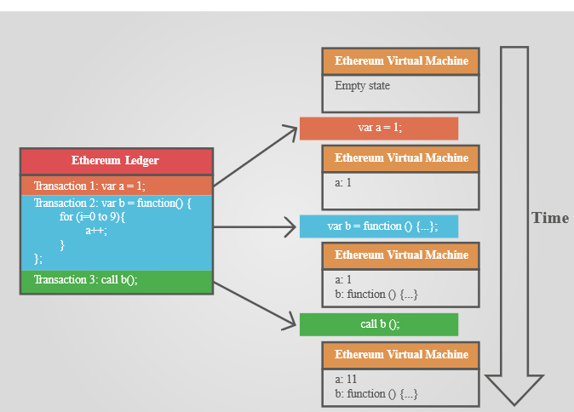
Ethereum
Forking

Slide 32
Ethereum
Forking

Slide 33
Ethereum
Gas
Ethereum transactions are coded and may include an infinite loop or a circular reference that never breaks, all of which can be seen as another type of attack.
To protect against such an attack, Ethereum introduces another concept, that of gas.
Gas is convertible from Ether, the currency of the Ethereum blockchain, is provided by the transaction creator and is consumed at each computational step:
If the computation stops before all the gas is consumed, the consumed gas is collected by the winning miner, and the remainder returned to the transaction creator.
If the gas provided is fully consumed before the computations have completed, the computation stops, all state changes dropped, and all gas goes to the winning miner.

Slide 34
Ethereum
Consensus Protocol
Ethereum uses Elliptic curve as its basis to sign and verify
http://mathworld.wolfram.com/EllipticCurve.html
https://anders.com/blockchain/public-private-keys/keys.html

Slide 35
Ethereum
Further Reading
https://github.com/ethereum/wiki/wiki/White-Paper
http://gavwood.com/Paper.pdf

Slide 36
Setting the development Environment

Slide 37
Tools Required
Node.js
Geth
Python4
C++
Truffle
Web3
Solc
TestRpc
MetaMask

Slide 39
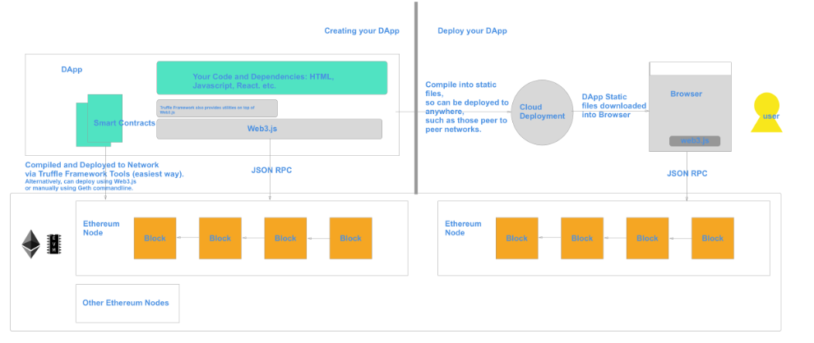

Slide 40
Installation
1. Install *Node.js* by going to [Node.js latest installer](https://nodejs.org/en/download/current/) and downloading the latest version.
2. Install *Geth* by going to [Geth installer](https://geth.ethereum.org/downloads/) and downloading the latest version.
3. Install *Python* by going to [Python installer] https://www.python.org/downloads/windows/
4. Install *C++ build tools* by going to https://www.microsoft.com/en-us/download/details.aspx?id=8279. Just select the redistributable option.
3. Go to c:\Program Files\nodejs
4. Install *testrpc* by typing 'npm install ethereumjs-testrpc web3@0.20.1'.
5. Install *truffle* by typing 'npm install -g truffle'.
6. in a command line 'AS ADMINISTRATOR' install generic tools by typing npm install -g -production windows-build-tools
7. Install *web3* by typing 'npm install web3'.
7. Install *solc* by typing 'npm install solc'.
7. Run testrpc by typing 'TestRpc' in the command prompt.
8. To install a blank template - truffle unbox webpack

Slide 41
Deploy a Contract
Demo

Slide 42
Simple Contracts
Examples

Slide 43
Solidity

Slide 44
Solidity
Solidity is a contract-oriented, high-level language for implementing smart contracts.
Influenced by C++, Python and JavaScript and is designed to target the Ethereum Virtual Machine (EVM).
Solidity is statically typed, supports inheritance, libraries and complex user-defined types among other features.

Slide 45
Solidity Elements

Slide 46
Solidity Elements
Structure of a Contract
Contracts in Solidity are similar to classes in object-oriented languages.
Each contract can contain declarations of State Variables, Functions, Function Modifiers, Struct Types and Enum Types.
Contracts can inherit from other contracts.

Slide 47
Types
There are value types, reference types and mappings.
Nulls do not exist in Solidity.
When you fetch a value that has not been set, you get the default value of its type.

Slide 48
Value types
There are 4 value types
Bool
Int
Uint
Address
Address is 160 bits long, and has the extra:
.balance
.send(uint) to send wei
.call(...) and delegatecall(...) to call the fallback function or a function by name, as a last resort.

Slide 49
Enum
Represented as uint
If you have 256, or fewer, values in your enum it will be equivalent to a uint8
If you have 65,536, or fewer, values it will be represented as uint16
enum Hand { Left, Right }
Hand myHand;
function getMyHand() returns (uint) { // In fact will be a uint8
return uint(myHand);
}
function setMyHand(uint newHand) {
myHand = Hand(newHand);
}

Slide 50
Array value types
Fixed sizes: bytes1 to bytes32.
Dynamic sizes: bytes, string encoded in UTF8.
Note that:
these arrays are returned by value, which costs gas.
dynamic sizes may only be returned by constant functions. The rationale is that it would make gas expenditure too random, or at least difficult to pre-estimate.

Slide 51
Reference types
These structures are passed by reference.
These are
Struct
Array
Struct lets you aggregate data into a logical entity. For instance:
struct Client
{
uint id;
string name;
}

Slide 52
Reference types
Arrays are available and behave as you expect them to. For instance:
uint[] clientIds;
Client[] clientInfos;
To read or write elements at an existing zero-based index, you call clientIds[2]
To add an element at the end, and thereby increase the length, you call clientIds.push(123)
To truncate an array to a given length, you call clientIds.length = 2

Slide 53
Data location
Reference variables are also assigned a location, such as memory or storage.
It is not necessary to always specify the location as there are default locations depending on where the declaration is.
However, it comes in handy when you want to avoid expensive copies between memory and storage. For instance:
contract Staff {
uint[] peopleIds; // defaults to storage
function test() {
processIds(peopleIds); // expensive
processIds2(peopleIds); // not expensive
}
function processIds(uint[] ids) { // defaults to memory
}
function processIds2(uint[] storage ids) { // forced to storage
}
}

Slide 54
State variables
Each contract instance can maintain a state.
This state consists of one of more variables of the types defined above.
These state variables can only be modified via a function call invoked within a transaction.
When a contract and/or its children have access to a state variable, they access it by its name to read and write:

Slide 55
Functions
Functions are pieces of executable code attached to a contract. They are declared:
with the word function
with parameters
with or without a return type, e.g. returns (uint)
The usual C/Javascript structures like for, do while, break, continue, if then else, a ? b : c and return are available.
Any function can receive Ether along with the transaction that calls it if, and only if, you add the payable keyword to it.

Slide 56
Mapping
A mapping associates a value behind a key.
Think of them as a map or hashtable.
A big difference is that every value is "already populated" with zeroes, and there is no .contains(key) method.
For instance:
mapping (address => uint) contributions; // contributions[whatever] is already set at 0
mapping (uint => Client) clientInfos;

Slide 57
Visibility specifiers
These variables are by default internal but can be declared with these visibility identifiers:
private: only the contract it is declared in can see it
internal: only the contract it is declared in and its child contracts can see it, this is the default
public: all can access it

Slide 58
Design patterns in Solidity

Slide 59
Design patterns
Contract Self Destruction
Factory Contract
Name Registry
Mapping Iterator
Sending ether from contract: Withdrawal pattern

Slide 60
Contract Self Destruction
Used for terminating a contract, which means removing it forever from the blockchain.
Once destroyed, it’s not possible to invoke functions on the contract and no transactions will be logged in the ledger.
Now comes the question “Why would I ever destroy my contract?”.
There are multiple reasons, such as dealing with timed contracts or contracts that must be terminated once a milestone has been reached or contracts that are obsolete.

Slide 61
Contract Self Destruction
Some things to keep in mind when dealing with a contract that has been destroyed:
Transactions will fail
Any funds sent to the contract will be lost
In order to prevent the loss of funds you should remove all references of dead contracts and/or call get() before sending funds to make sure the contract still exists.

Slide 62
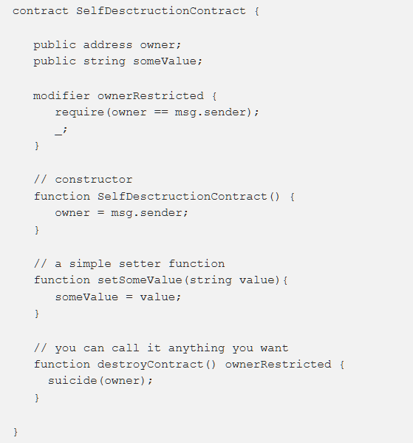

Slide 63
Factory Contract
Factory contract is used to create and deploy “child” contracts. Those child contracts can be referred to as “assets” which in the real life could represent, say, a house or a car.
The factory is used for storing the child contracts’ addresses so that they can be extracted whenever necessary.
By storing them in the contract they remain in the blockchain and they are pretty much safe there, while data corruption in your database might wipe the asset contracts’ addresses which will lead to losing references to those contracts.
A common use case for the Factory contract is selling assets and keeping track of those assets (eg. who is the owner). To sell an asset you add the payable modifier to the functions responsible for deploying the assets.

Slide 64
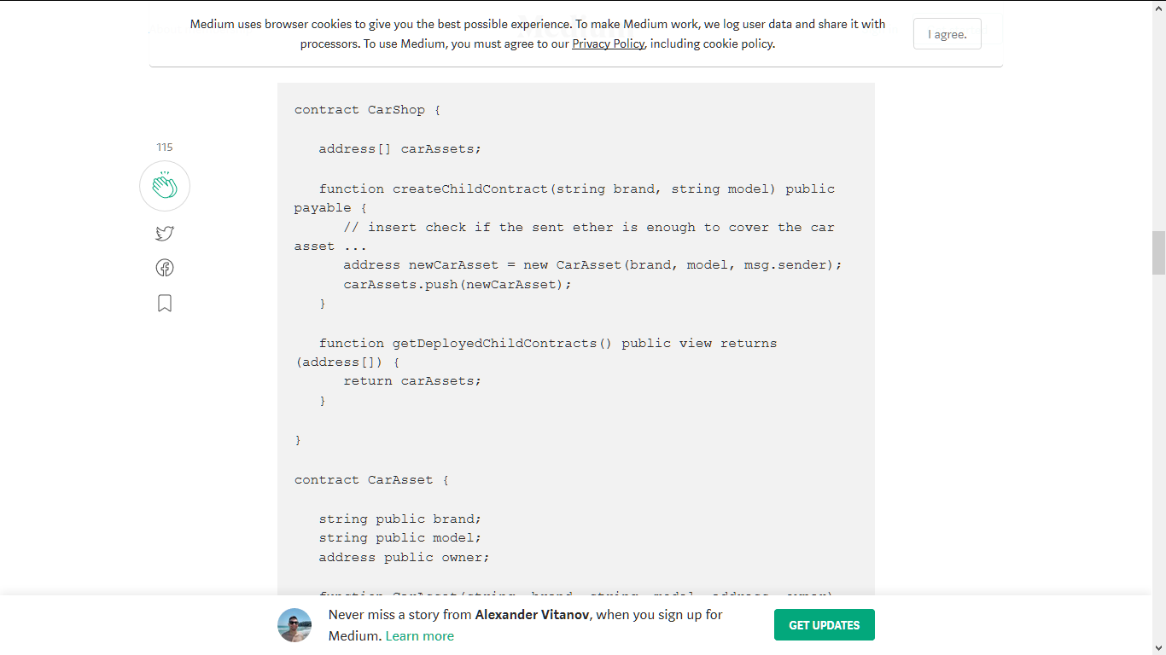
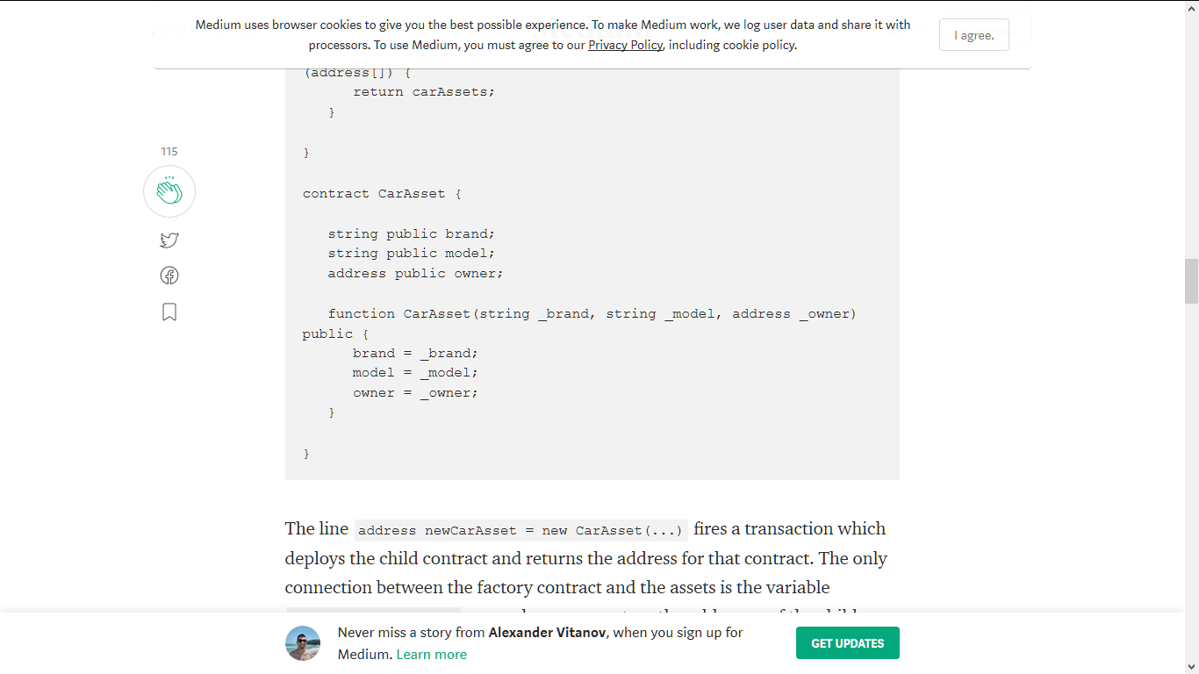
Factory Contract

Slide 65
Factory Contract
The line address newCarAsset = new CarAsset(...) fires a transaction which deploys the child contract and returns the address for that contract.
The only connection between the factory contract and the assets is the variable address[] carAssets;
The addresses of the child contracts is the only connection so it must be stored.

Slide 66
Name Registry
Imagine you are building a DApp which has a dependency on multiple contracts
It would be hard to keep all those addresses inside your app’s code. There might be an addresses change over time or even more annoying, while developing you are deploying all those contracts every time you make changes and you have to keep track of their addresses.
This is where Name Registry comes into play. This pattern allows you to only keep the address of one contract, instead of tens, hundreds or even thousands, as your DApp grows in scale.
It works by storing a mapping contract name => contract address so each address can be looked up from within the DApp by calling getAddress(“ContractX").
The benefit of storing names mapped to addresses is that with the introduction of new versions of some contracts the DApp will not be affected in any way since the only thing we modify is just the address of the mapping.

Slide 67
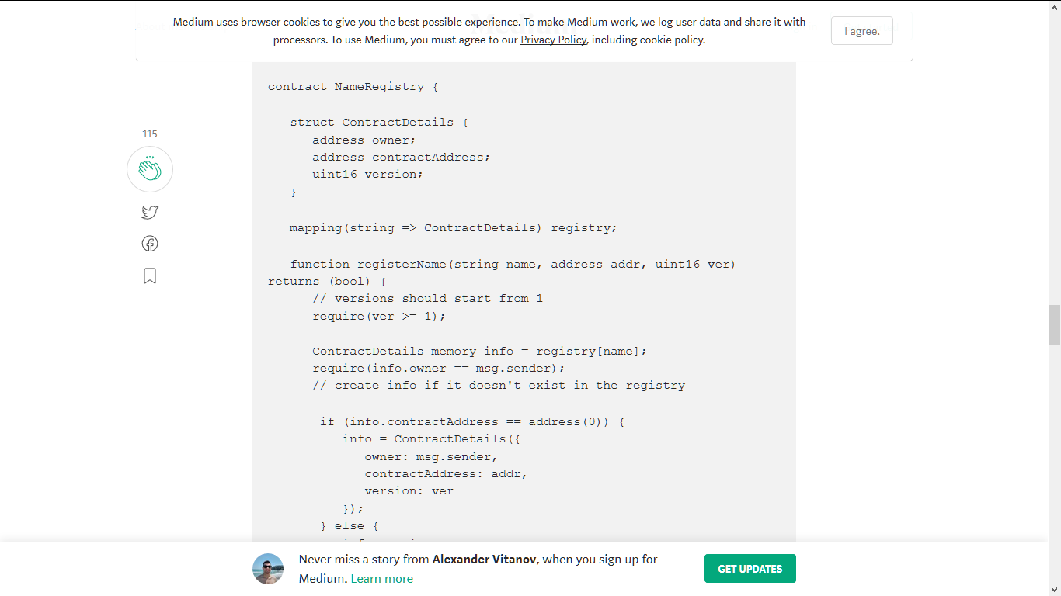
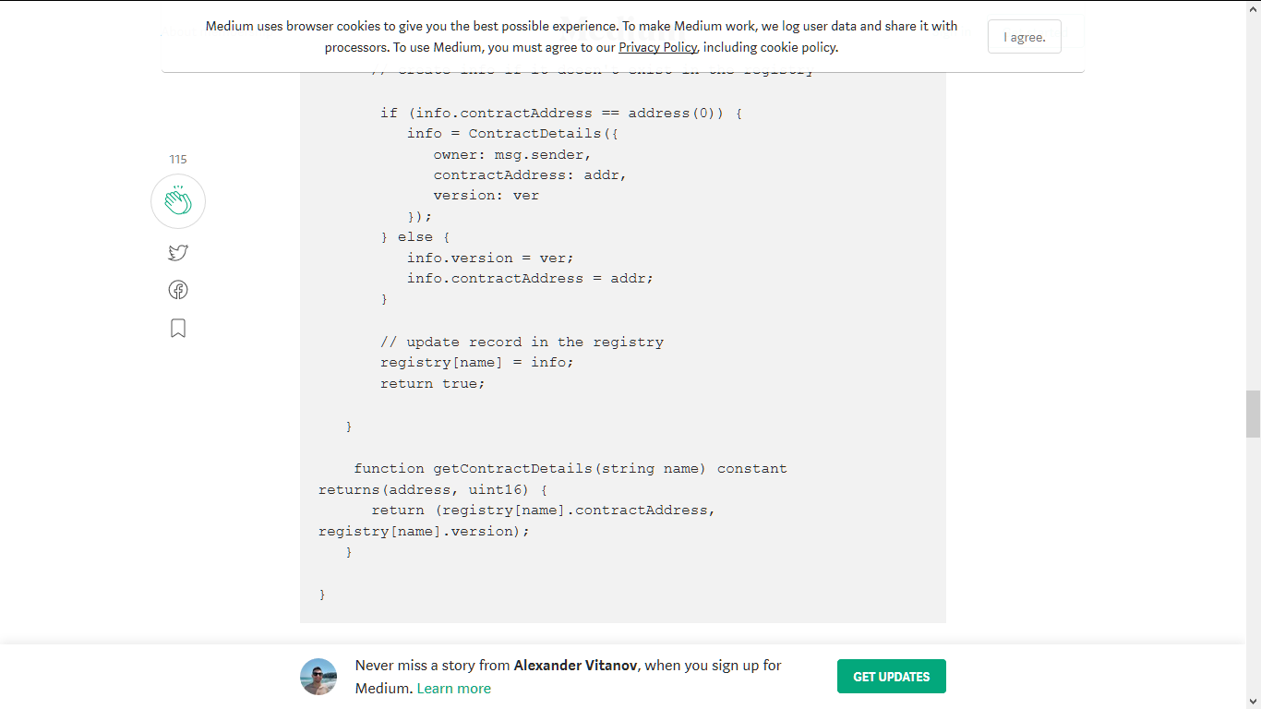

Slide 68
Mapping Iterator
Many times we need to iterate a mapping, but since mappings in Solidity cannot be iterated and they only store values, the Mapping Iterator pattern turns out to be extremely useful.
Some things to keep in mind are that as elements count goes up the complexity of iteration will increase, as well as the storage cost, so avoid iterating when possible.

Slide 69
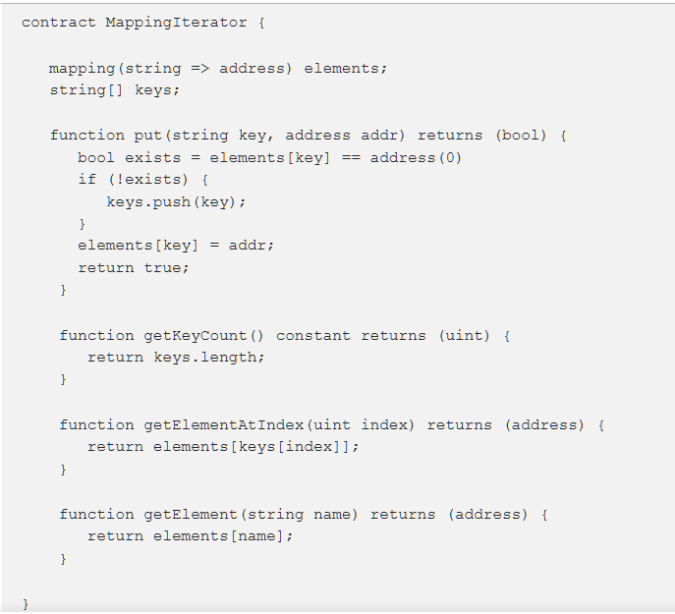

Slide 70
Withdrawal Pattern
Imagine you sell car tires. All the tires you’ve sold turn out to be faulty in some fashion and you offer a refund to everyone who paid for them.
Let’s say you keep track of all buyers in a contract and you have a refund function which iterates through your buyers list and sends back the money to each one of them.
You have a choice - use buyerAddress.transfer() or buyerAddress.send() .
The difference between both functions is that transfer() will throw an exception if something goes wrong with the transaction while send() will not throw but simply return a boolean false .

Slide 71
Withdrawal Pattern
Why is this important?
Let’s say most buyers are external accounts (i.e. individuals), but some buyers are other contracts (perhaps businesses). Assume that among those buyer contracts there is one contract whose developers made a mistake in its fallback function and it throws an exception when invoked (fallback functions are default functions in contracts that are invoked if a transaction is sent to the contract without specifying any methods). Now as soon as we invoke contractWithError.transfer() in our refund function an exception will be thrown and iteration will be stopped. Therefore, transaction is reverted and none of the buyers gets their refund. They are blocked.

Slide 72
Withdrawal Pattern
While refunding all buyers in one invocation can be implemented using send() , it is instead better to expose withdrawFunds() function which will refund callers on demand, individually. Thus, the erroneous contract will not block the rest of the buyers and will only receive funds when the fallback function code is fixed.

Slide 73
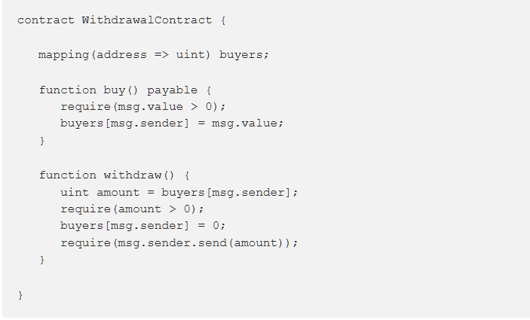

Slide 74
Security in Solidity

Slide 75
Security attacks types
Overflows & Underflows
Delegatecall
Reentrancy (TheDAO hack)
Forcing ether to a contract
Call to the Unknown (DoS with unexpected revert)
Short Address Attack

Slide 76
Overflows & Underflows
An overflow is when a number gets incremented above its maximum value. Solidity can handle up to 256 bit numbers (up to 2²⁵⁶-1), so incrementing by 1 would result into 0.
Likewise, in the inverse case, when the number is unsigned, decrementing will underflow the number, resulting in the maximum possible value.
As dangerous as both cases are, the underflow case is the more likely to happen, for example in the case where a token holder has X tokens but attempts to spend X+1. If the code does not check for it, the attacker might end up being allowed to spend more tokens than he had and have a maxed out balance.

Slide 77
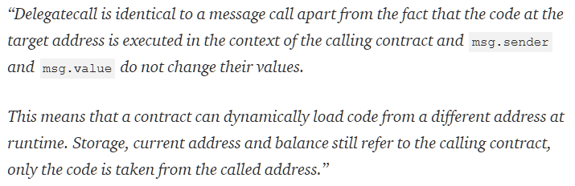
Delegatecall
It was the Parity wallet hack which cost users about 30 million dollars.
This low-level function has been very useful as it’s the backbone for implementing Libraries and modularizing code. However it opens up the doors to vulnerabilities as essentially your contract is allowing anyone to do whatever they want with their state.

Slide 78
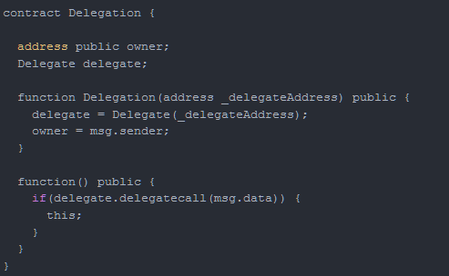
Delegatecall
In the example below, an attacker can call contract Delegate’s public function pwn and since the call is in the context of Delegation, they can claim ownership of the contract.

Slide 79
Delegatecall
The Parity hack involved a combination of both insecure visibility modifiers and misuse of delegate call with abritrary data. The vulnerable contract’s function implemented delegatecall and a function from another contract that could modify ownership was left public. That allowed an attacker to craft the msg.data field to call the vulnerable function.
As for what would be included in the msg.data field, that is the signature of the function that you want to call. Signature here means the first 8 bytes of the sha3 (alias for keccak256)hash of the function prototype.

Slide 80
Delegatecall
In this case:
web3.sha3("pwn()").slice(0, 10) --> 0xdd365b8b
If the function takes an argument, pwn(uint256 x):
web3.sha3("pwn(uint256)").slice(0,10) --> 0x35f4581b

Slide 81
Reentrancy (TheDAO hack)
Solidity’s call function when called with value forwards all the gas it received.
In the next example, the call is made before actually reducing the sender’s balance.
This opened up a vulnerability which known as The DAO hack

Slide 82
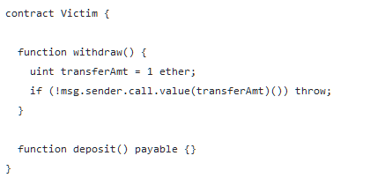
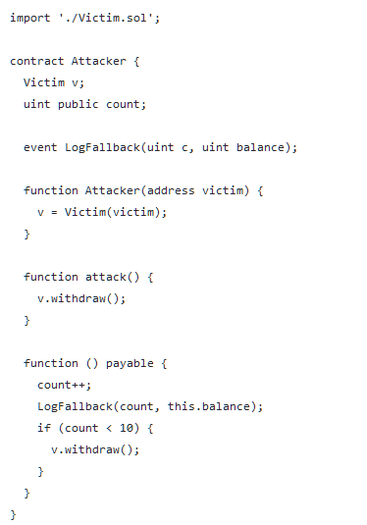

Slide 83
Forcing ether to a contract
Solidity’s selfdestruct does two things.
It renders the contract useless, effectively deleting the bytecode at that address.
It sends all the contract’s funds to a target address.
The special case here, is that if the receiving address is a contract, its fallback function does not get executed.
This means that if a contract’s function has a conditional statement that depends on that contract’s balance being below a certain amount, that statement can be potentially bypassed.

Slide 84
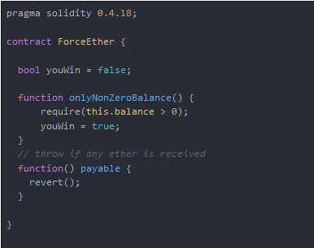

Slide 85
Call to the Unknown (DoS with unexpected revert)
In this case, an attacker’s contract could first claim leadership by sending enough ether to the insecure contract. Then, the transactions of another player who would attempt to claim leadership would throw due to line 25 in the above snippet.
Although a simple attack, this causes a permanent denial of service to the contract rendering it useless. This can be found in other ponzi scheme contracts that follow the same pattern.

Slide 86

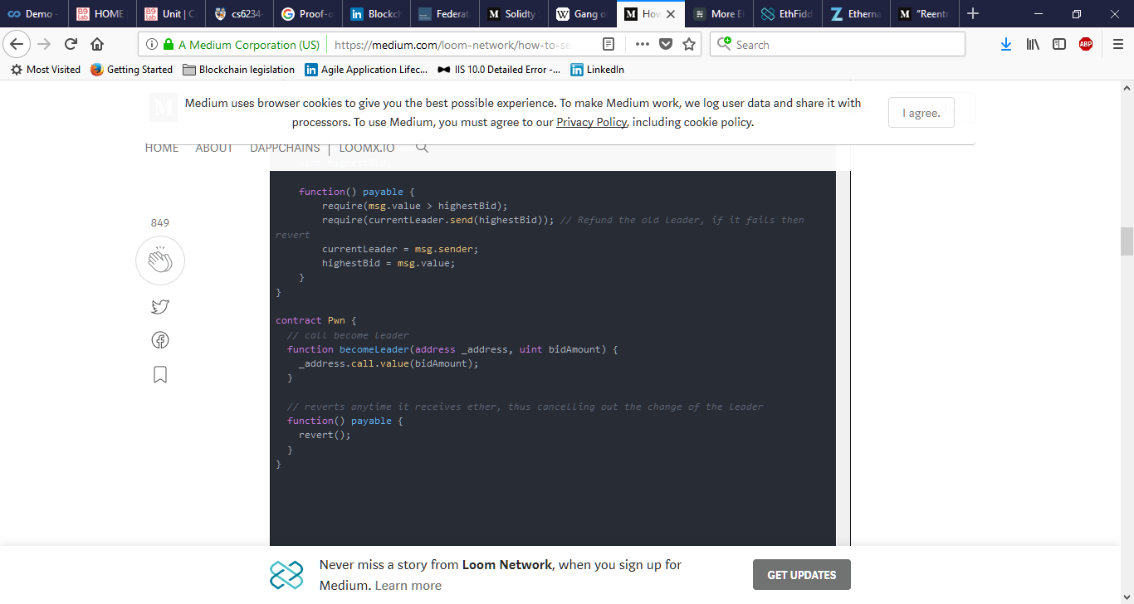

Slide 87
Short Address Attack
This vulnerability allows an attacker to abuse the transfer function and withdraw a larger amount of ERC20 tokens than he is allowed to.
To explain this bug let’s consider an exchange having a wallet with 10000 tokens and a user with a balance of 32 tokens on that exchange’s wallet.
Let’s also consider that this user’s address is 0x12345600 — notice the trailing zeroes — and that they want to withdraw an amount larger than their balance.
To do that they would go to the exchange and click the token’s withdraw button and input their address without the trailing zeroes

Slide 88
Short Address Attack
The ERC20’s transfer function is formulated as transfer(address to, uint256 amount). The 3 fields would be as follows:
sig : a9059cbb = web3.sha3("transfer(address,uint256)").slice(0,10)
arg1: 123456 = receiving address
arg2: 00000020 = 32 in hexademical (0x20)
Concatenated: a9059cbb 123456 00000020
Transaction input data: 0xa9059cbb12345600000020

Slide 89
Short Address Attack
Looking closely, the transaction’s length is 2 bytes shorter (4 bytes in the real world with full words). The EVM in this case would pad the transaction with trailing zeroes, resulting in:
0xa9059cbb1234560000002000
// a9059cbb = web3.sha3("transfer(address,uint256)").slice(0,10)
// 12345600 = receiving address
// 00002000 = 8192 in hexademical

Slide 90
Testing Smart Contracts
Demo

